Slide 1
OAR Lib: An Open Source Arc Routing Library
By Oliver Lum
Advised By Professor Bruce Golden

Slide 2
What is Arc Routing?
Introduction
Conclusion
Schedule
Validation
Approach
Visit edges, minimize cost
Ubiquitous:
Package Delivery
Snow Plowing
Military Patrols
Various interesting wrinkles:
Time-Windows
Turn Penalties
Asymmetric Costs

Slide 3
Motivation
Introduction
Conclusion
Schedule
Validation
Approach
Provide research community with standard, efficient implementation for ease of comparison.
Reduce start-up overhead for budding operations researchers.
Begin personal research.
Provide a set of Java based tools that can lay the groundwork for easy extensibility.

Slide 4
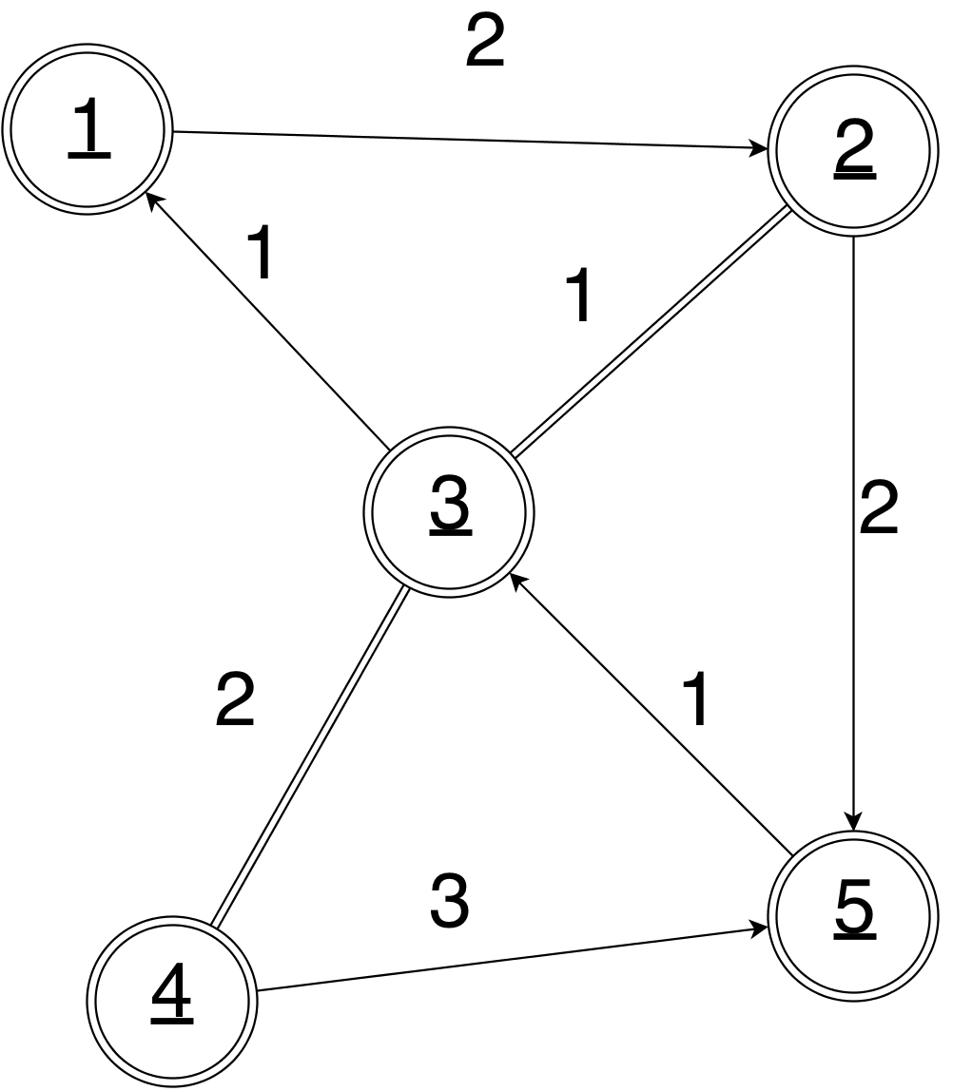
Definitions
Introduction
Conclusion
Schedule
Validation
Approach
Graphs
Undirected: (V,E)
Directed: (V,A)
Mixed: (V,E,A)
Windy: (V,E)
Vertex
Edge: (i, j)
Degree
Euler Tour
Strongly Connected

Slide 5
Objective
Introduction
Conclusion
Schedule
Validation
Approach
P vs. NP:
The major dividing line in computational tractability.
Asymptotic complexity makes solving all interesting arc routing problems to optimality impossible, (working assumption that P ~= NP).
Heuristics attempt to get close, in polynomial time.

Slide 6
Problems / Algorithms
Introduction
Conclusion
Schedule
Validation
Approach
Problem | Classical | Modern
Undirected Chinese Postman Problem | Edmonds | N/A
Directed Chinese Postman Problem | Thimbleby | N/A
Mixed Chinese Postman Problem | Frederickson | Yaoyuenyeung
Windy Chinese Postman Problem | Win | Benavent
Directed Rural Postman Problem | Christofides | Benavent

Slide 7
The Undirected Chinese Postman
Introduction
Conclusion
Schedule
Validation
Approach
Requirement: Visit every edge in the graph, and return to the starting node (closed).
Graph: (Connected) Only Edges

Slide 8
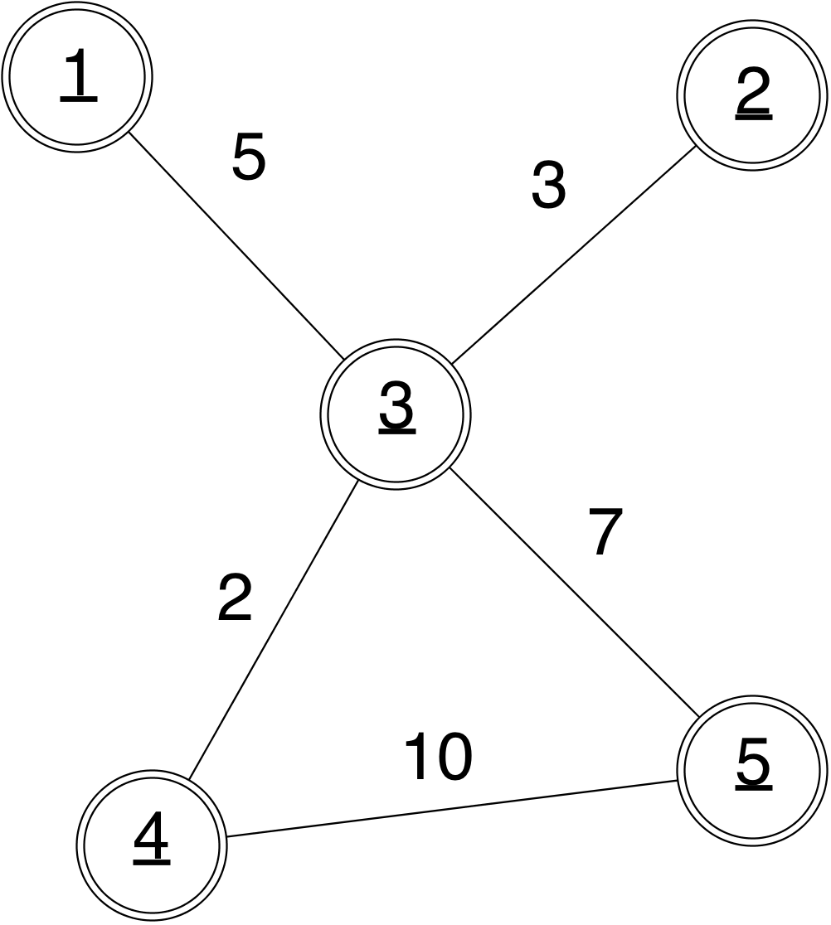
The Undirected Chinese Postman: Algorithms
Introduction
Conclusion
Schedule
Validation
Approach
Euler Tour Theorem: A connected, undirected graph has a tour visiting each edge exactly once iff every node has even degree.
Idea
Step I: Identify nodes with odd-degree.
Step II: Optimally connect them so that they now have even degree, yielding an augmented graph.
Step III : Construct the Euler tour on this augmented graph.

Slide 9
The Undirected Chinese Postman
Introduction
Conclusion
Schedule
Validation
Approach
Cost function: C
Edge set: E
Vertex set: V
t_{e} : represents number of additional times we traverse edge e.
$δ(v)$: set of edges incident on v.

Slide 10
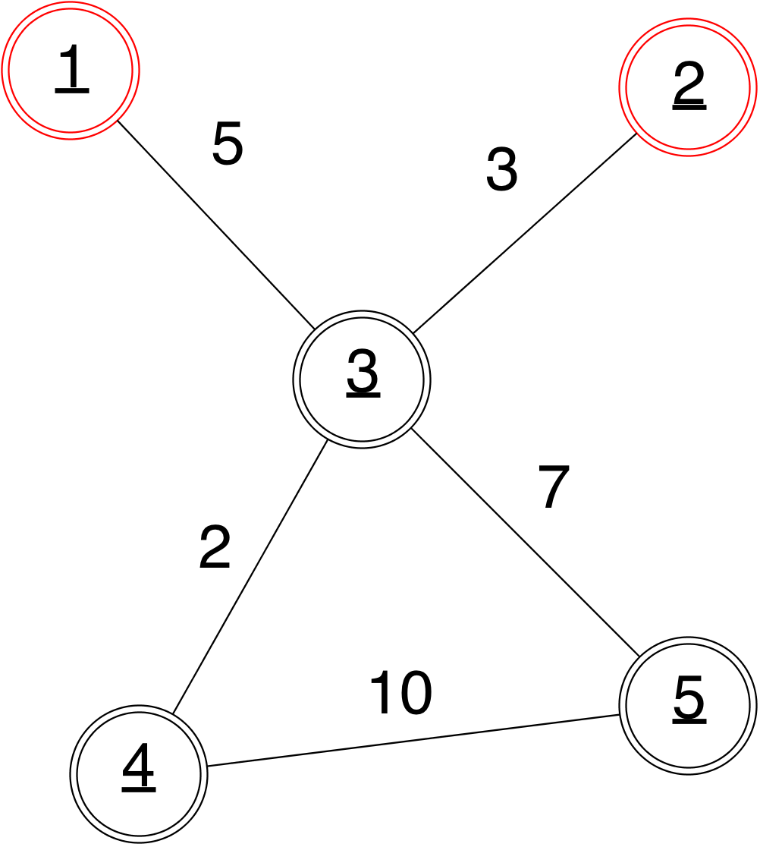
The Undirected Chinese Postman: Algorithms
Introduction
Conclusion
Schedule
Validation
Approach
Euler Tour Theorem: A connected, undirected graph has a tour visiting each edge exactly once iff every node has even degree.
Idea
Step I: Identify nodes with odd-degree.
Step II: Optimally connect them so that they now have even degree, yielding an augmented graph.
Step III : Construct the Euler tour on this augmented graph.

Slide 11
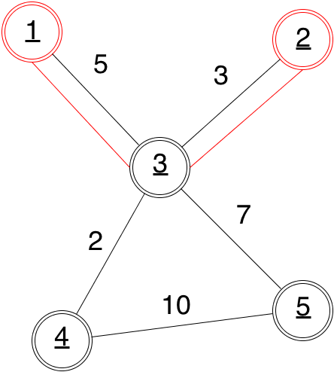
The Undirected Chinese Postman: Algorithms
Introduction
Conclusion
Schedule
Validation
Approach
Euler Tour Theorem: A connected, undirected graph has a tour visiting each edge exactly once iff every node has even degree.
Idea
Step I: Identify nodes with odd-degree.
Step II: Optimally connect them so that they now have even degree, yielding an augmented graph.
Step III : Construct the Euler tour on this augmented graph.

Slide 12
The Undirected Chinese Postman: Algorithms
Introduction
Conclusion
Schedule
Validation
Approach
Euler Tour Theorem: A connected, undirected graph has a tour visiting each edge exactly once iff every node has even degree.
Idea
Step I: Identify nodes with odd-degree.
Step II: Optimally connect them so that they now have even degree, yielding an augmented graph.
Step III : Construct the Euler tour on this augmented graph.

Slide 13
The Undirected Chinese Postman: Algorithms
Introduction
Conclusion
Schedule
Validation
Approach
Step II:
In order to connect the odd nodes in a least-cost way, we may use any matching algorithm.
Step III:
Once we have an Eulerian graph, we may construct an Euler tour by using Fleury’s algorithm.

Slide 14
The Directed Chinese Postman
Introduction
Conclusion
Schedule
Validation
Approach
Requirement: Visit every edge in the graph, returning to the starting node (closed).
Graph: (Strongly Connected) Only Arcs

Slide 15
The Directed Chinese Postman: Algorithms
Introduction
Conclusion
Schedule
Validation
Approach
Euler Tour Theorem: A strongly connected, directed graph has a tour visiting each edge exactly once iff every node has in-degree = out-degree.
Idea
Step I: Identify nodes with a degree imbalance.
Step II: Optimally add paths between them until they’re all balanced.
Step III : Construct the Euler tour on this augmented graph.

Slide 16
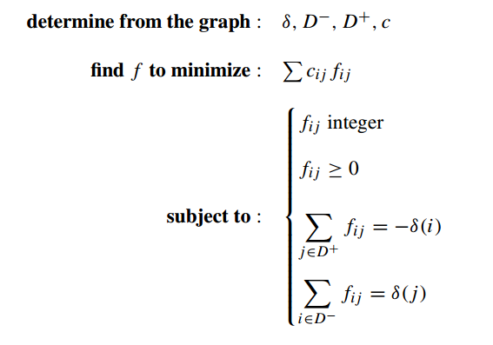
The Directed Chinese Postman
Introduction
Conclusion
Schedule
Validation
Approach
Cost function: C
f_{ij} : represents number of additional times we traverse the shortest path from i to j.
$δ\left(v\right):$ outdegree – indegree of vertex v.
$D^{+}$: set of vertices with excess outgoing arcs.
$D^{−}$: set of vertices with excess incoming arcs.

Slide 17
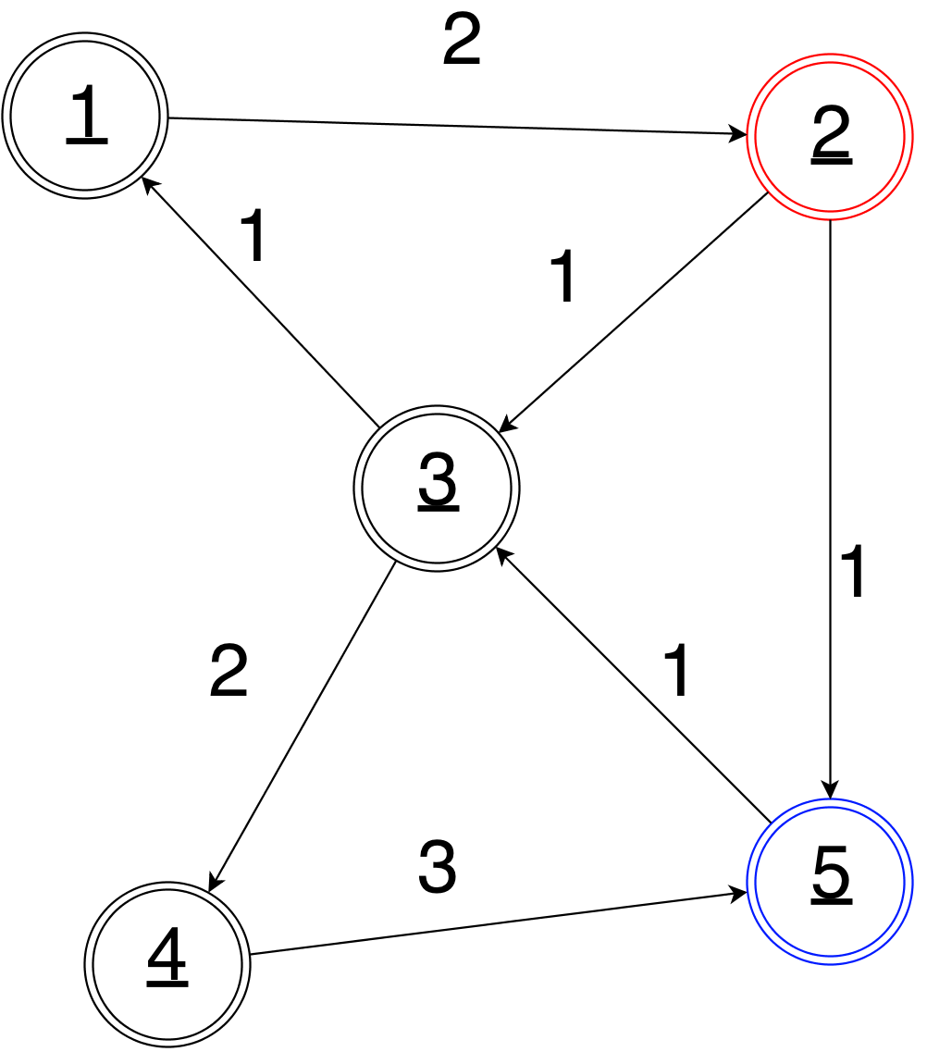
The Directed Chinese Postman: Algorithms
Introduction
Conclusion
Schedule
Validation
Approach
Euler Tour Theorem: A strongly connected, directed graph has a tour visiting each edge exactly once iff every node has in-degree = out-degree.
Idea
Step I: Identify nodes with a degree imbalance.
Step II: Optimally add paths between them until they’re all balanced.
Step III : Construct the Euler tour on this augmented graph.

Slide 18
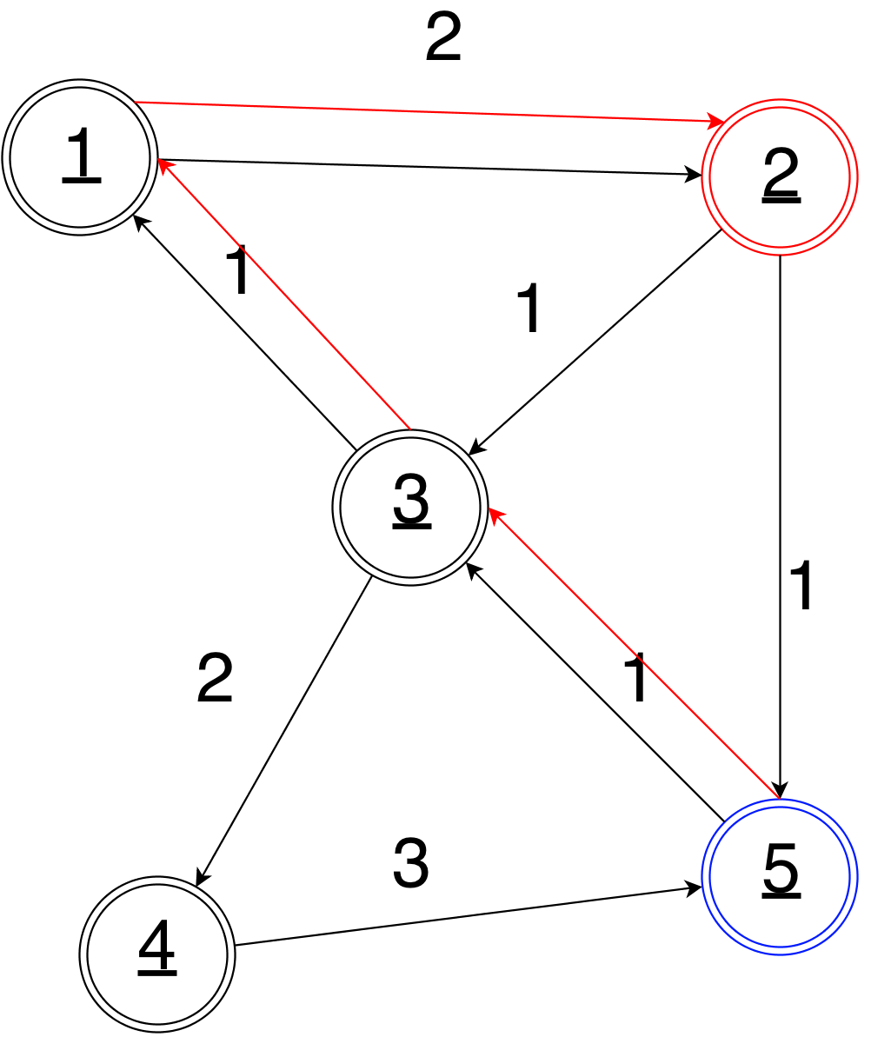
The Directed Chinese Postman: Algorithms
Introduction
Conclusion
Schedule
Validation
Approach
Euler Tour Theorem: A strongly connected, directed graph has a tour visiting each edge exactly once iff every node has in-degree = out-degree.
Idea
Step I: Identify nodes with a degree imbalance.
Step II: Optimally add paths between them until they’re all balanced.
Step III: Construct the Euler tour on this augmented graph.

Slide 19
The Directed Chinese Postman: Algorithms
Introduction
Conclusion
Schedule
Validation
Approach
Euler Tour Theorem: A strongly connected, directed graph has a tour visiting each edge exactly once iff every node has in-degree = out-degree.
Idea
Step I: Identify nodes with a degree imbalance.
Step II: Optimally add paths between them until they’re all balanced.
Step III : Construct the Euler tour on this augmented graph.

Slide 20
The Mixed Chinese Postman
Introduction
Conclusion
Schedule
Validation
Approach
Requirement: Visit every edge in the graph, and return to the starting node.
Graph: Mix of Edges and Arcs

Slide 21
The Mixed Chinese Postman: Algorithms
Introduction
Conclusion
Schedule
Validation
Approach
Euler Tour Theorem: A strongly connected, mixed graph has a tour visiting each edge exactly once if every node has in-degree = out-degree, and is of even degree.
Phase I: Even Degree
Phase II: In-Out-Degree
Phase III: Even Parity

Slide 22
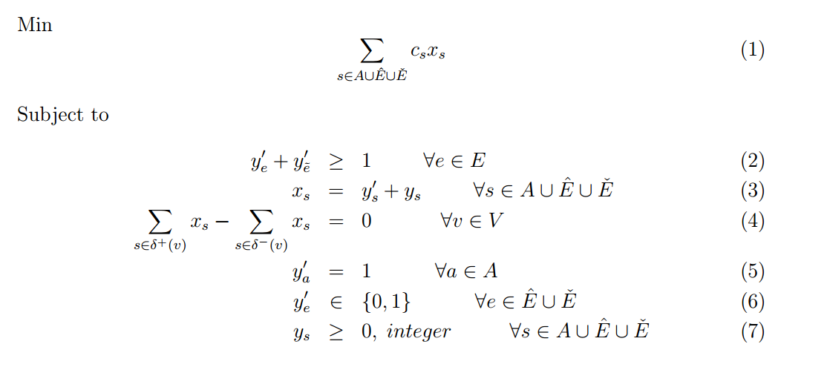
The Mixed Chinese Postman
Introduction
Conclusion
Schedule
Validation
Approach
Cost function: C
x_{s} : represents number of times we traverse link s.
$δ^{+}\left(v\right):$ arcs / directed edges going out of v.
$y_{e}^{′}:$ 1 if we orient edge e from i to j, 0 oth.
$y_{s}$: the number of additional times we traverse link s.

Slide 23
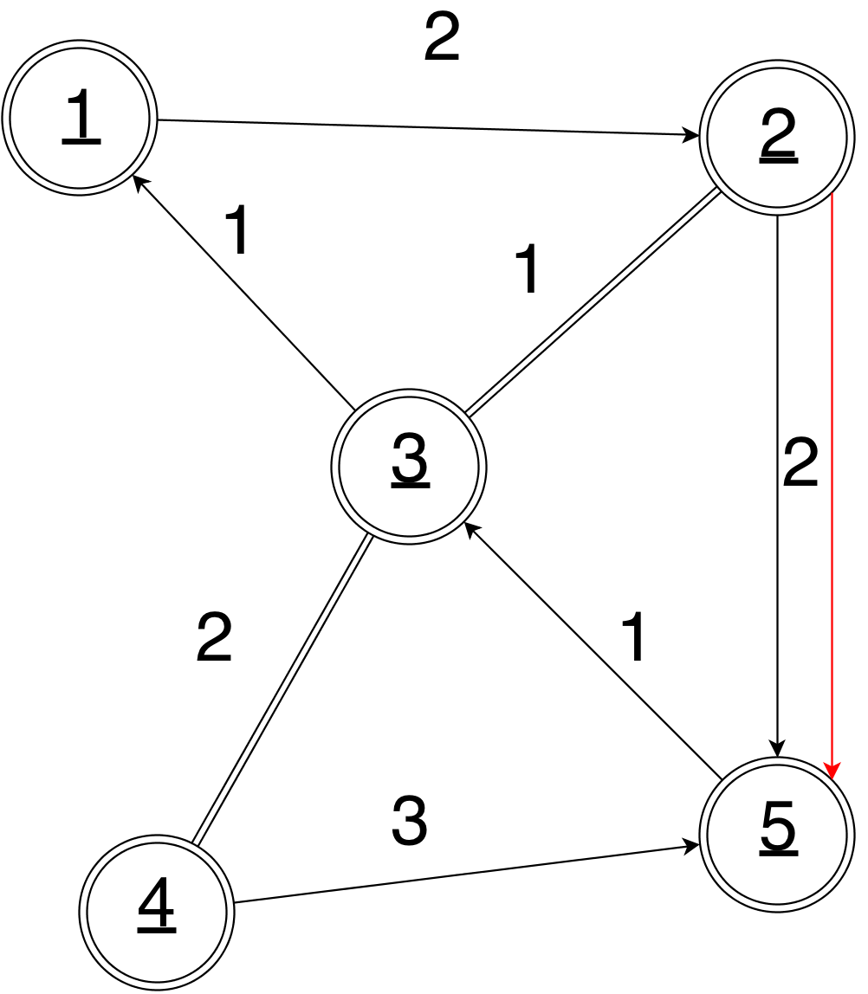
The Mixed Chinese Postman: Algorithms
Introduction
Conclusion
Schedule
Validation
Approach
Phase I: Even Degree
Solve the UCPP on the mixed graph, ignoring arc direction. Then, add arcs and edges corresponding to the paths from the matching.
Phase II: In-Out-Degree
Phase III: Even Parity

Slide 24
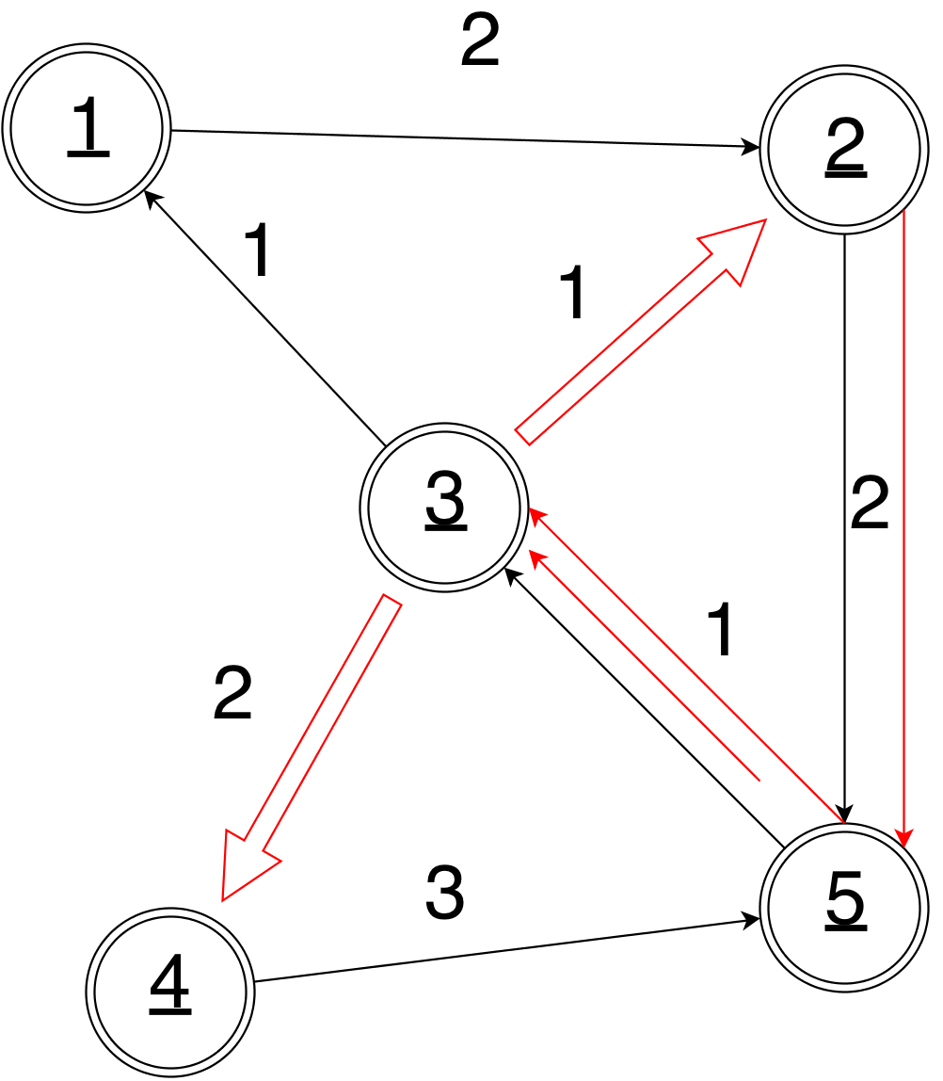
The Mixed Chinese Postman: Algorithms
Introduction
Conclusion
Schedule
Validation
Approach
Phase I: Even Degree
Phase II: In-Out-Degree
Solve the DCPP on the graph, where each edge is replaced by two arcs (one per direction), keeping track of the flow solution to determine which direction the (original) edges get oriented, and if any other augmentations are needed.
Phase III: Even Parity

Slide 25
The Mixed Chinese Postman: Algorithms
Introduction
Conclusion
Schedule
Validation
Approach
Phase I: Even Degree
Phase II: In-Out-Degree
Phase III: Even Parity
We search for cycles that consist of alternating paths between odd-nodes. Alternating here means switching between paths that are composed of edges left undirected after Phase II, and paths that are composed of added arcs, (irrespective of direction).

Slide 26
The Mixed Chinese Postman: Algorithms
Introduction
Conclusion
Schedule
Validation
Approach
Phase I: Even Degree
Phase II: In-Out-Degree
Phase III: Even Parity
Do the reverse procedure, (symmetry first, then evenness), and pick the better answer.

Slide 27
The Mixed Chinese Postman: Algorithms II
Introduction
Conclusion
Schedule
Validation
Approach
Use Results from Frederickson, along with two observations:
We should replace added arcs or directed edges with shortest paths if they’re less costly.
If we have an edge connecting nodes i and j, and we can construct two paths from i to j that incur savings, then we can simply reverse the orientation of this edge and add the paths.

Slide 28
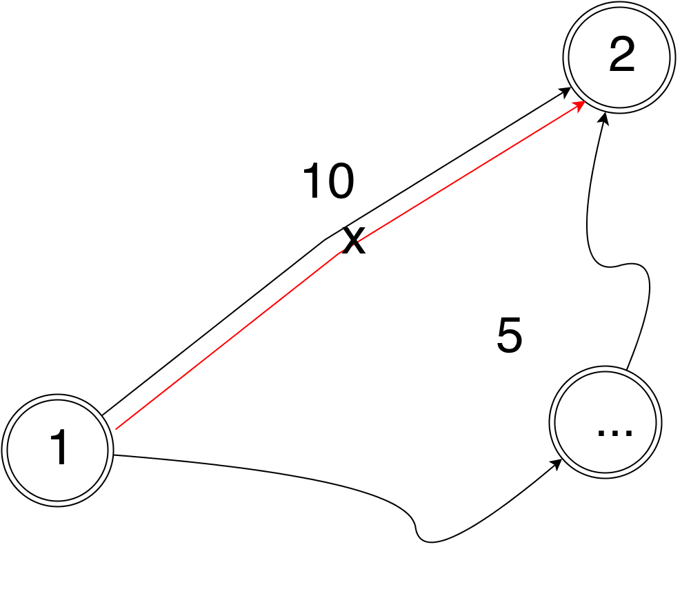
The Mixed Chinese Postman: Algorithms II
Introduction
Conclusion
Schedule
Validation
Approach
Use Results from Frederickson, along with two observations:
We should replace added arcs or directed edges with shortest paths if they’re less costly.
If we have an edge connecting nodes i and j, and we can construct two paths from i to j that incur savings, then we can simply reverse the orientation of this edge and add the paths.

Slide 29
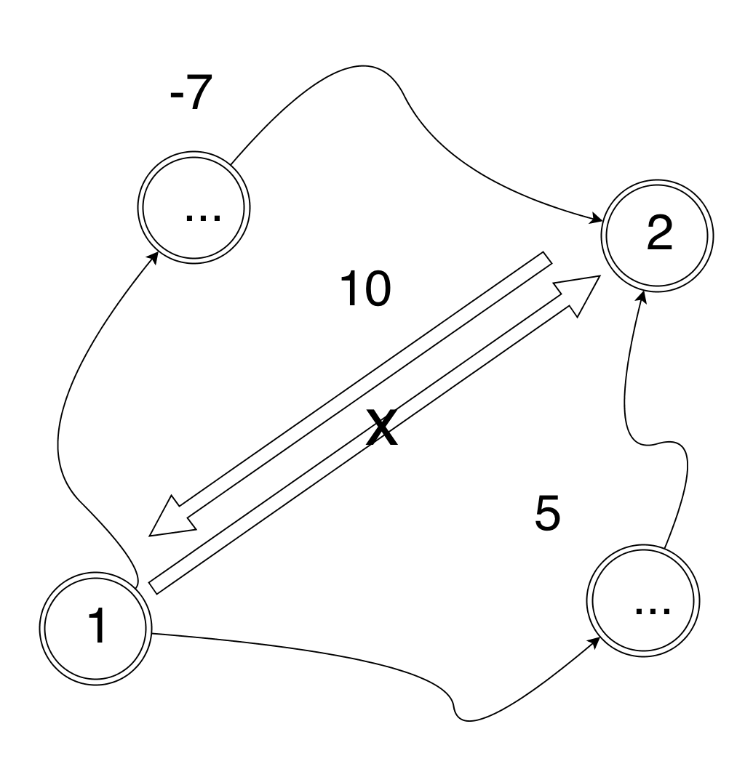
The Mixed Chinese Postman: Algorithms II
Introduction
Conclusion
Schedule
Validation
Approach
Use Results from Frederickson, along with two observations:
We should replace added arcs or directed edges with shortest paths if they’re less costly.
If we have an edge connecting nodes i and j, and we can construct two paths from i to j that incur savings, then we can simply reverse the orientation of this edge and add the paths.

Slide 30
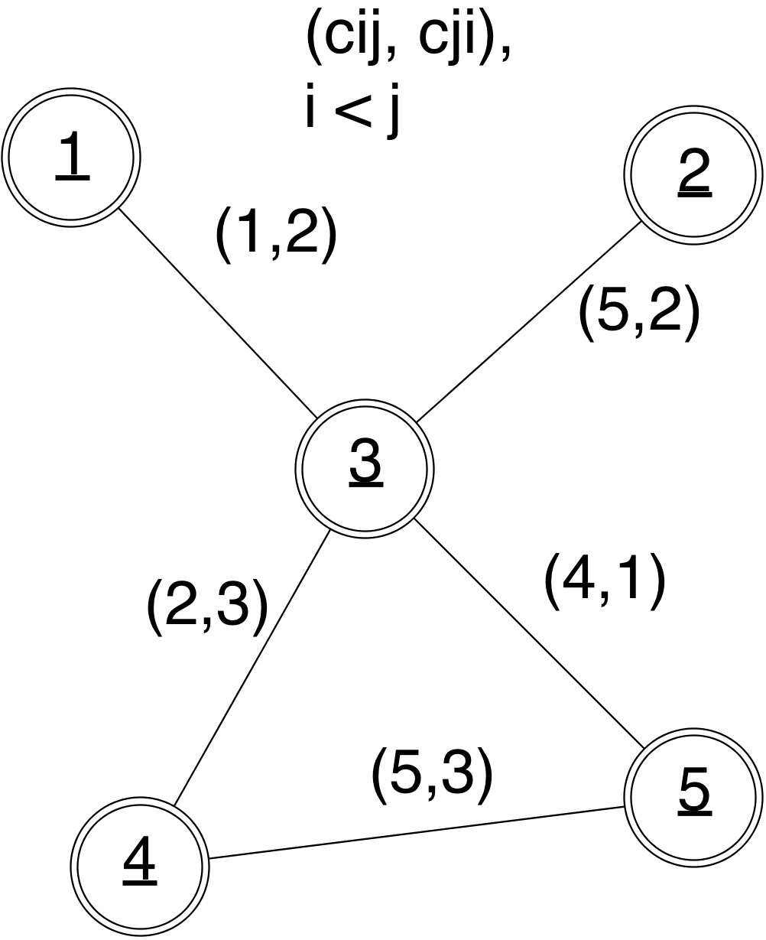
The Windy Chinese Postman
Introduction
Conclusion
Schedule
Validation
Approach
Requirement: Visit every edge in the graph, and return to the starting node.
Graph: (Connected), Edges only, but can possibly have asymmetric costs (and therefore simulate arcs).

Slide 31
The Windy Chinese Postman: Algorithms
Introduction
Conclusion
Schedule
Validation
Approach
Idea: if G is Eulerian, then there is a polynomial algorithm to determine a min-cost windy tour, so, let’s make it Eulerian!

Slide 32
The Windy Chinese Postman: Algorithms
Introduction
Conclusion
Schedule
Validation
Approach
Idea: if G is Eulerian, then there is a polynomial algorithm to determine a min-cost windy tour, so, let’s make it Eulerian!
Solve the UCPP using average edge costs.

Slide 33
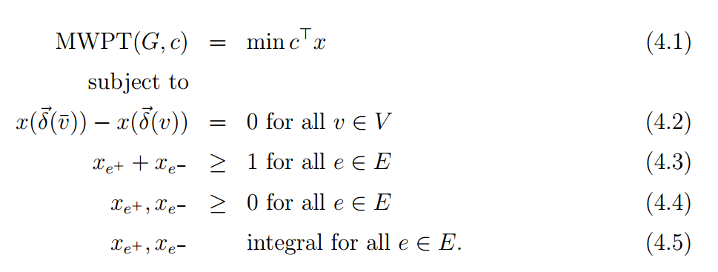
The Windy Chinese Postman
Introduction
Conclusion
Schedule
Validation
Approach
Cost function: C
$x_{e^{+}}$ : represents number of times we traverse edge e from i to j.
$δ\left(v\right):$ arcs / directed edges going into v.

Slide 34
The Windy Chinese Postman: Algorithms
Introduction
Conclusion
Schedule
Validation
Approach
Idea: if G is Eulerian, then there is a polynomial algorithm to determine a min-cost windy tour, so, let’s make it Eulerian!
Solve the UCPP using average edge costs.
Construct the optimal tour over the resulting graph (involves solving a min-cost flow over a digraph where each there is are three arcs per edge, one of them being of average cost).

Slide 35
The Windy Chinese Postman: Algorithms II
Introduction
Conclusion
Schedule
Validation
Approach
Average costs aren’t everything, let’s try giving precedence to edges where the cost asymmetry is highest, (more than 20% of the total average cost).
Direct edges like this in the direction of lowest cost.
Solve a min-cost flow problem where demands are determined only by these high stakes edges.
Edges in the solution are given zero cost when solving the UCPP.
Use some of the local improvement procedures we’ve already seen:
Replace non-required paths with shortest paths.
Get rid of redundant cycles.

Slide 36
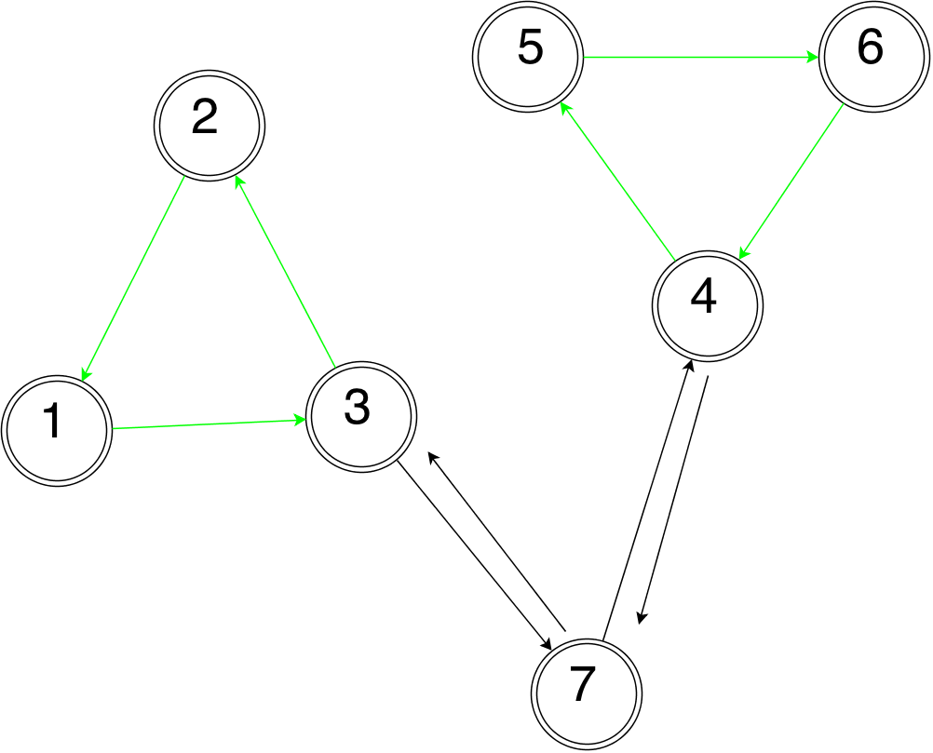
The Directed Rural Postman
Introduction
Conclusion
Schedule
Validation
Approach
Requirement: Visit a subset of edges in the graph that are labeled as “required.”
Graph: Only Arcs

Slide 37
The Directed Rural Postman: Algorithms
Introduction
Conclusion
Schedule
Validation
Approach
Idea: Connect the components of the graph induced by the required arcs, and then solve a min-cost flow problem.
Step I: Simplify the graph.
Step II: Find an MST on the collapsed graph.
Step III: Solve a min-cost flow problem on the resulting graph.

Slide 38
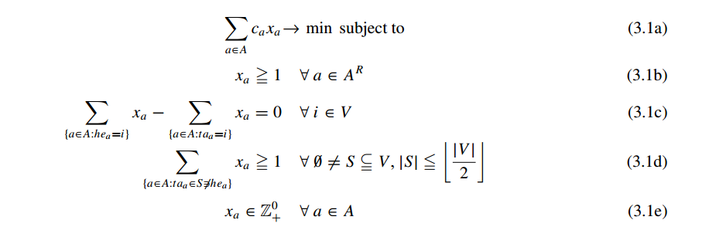
The Directed Rural Postman
Introduction
Conclusion
Schedule
Validation
Approach
Cost function: C
Set of required arcs: $A^{R}$
Set of vertices: $V$
x_{a} : represents number of times we traverse arc a.

Slide 39
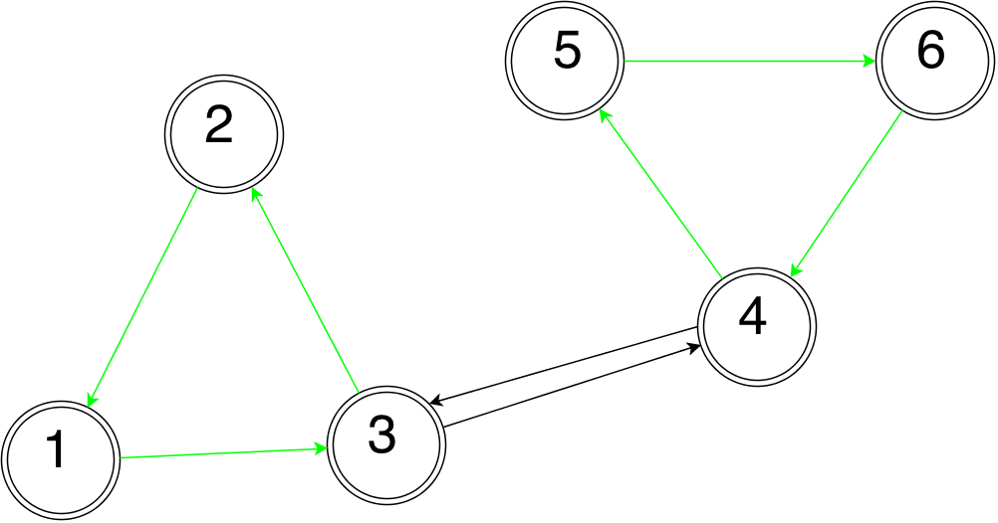
The Directed Rural Postman: Algorithms
Introduction
Conclusion
Schedule
Validation
Approach
Idea: Connect the components of the graph induced by the required arcs, and then solve a min-cost flow problem.
Step I: Simplify the graph.
Step II: Find an MST on the collapsed graph.
Step III: Solve a min-cost flow problem on the resulting graph.

Slide 40
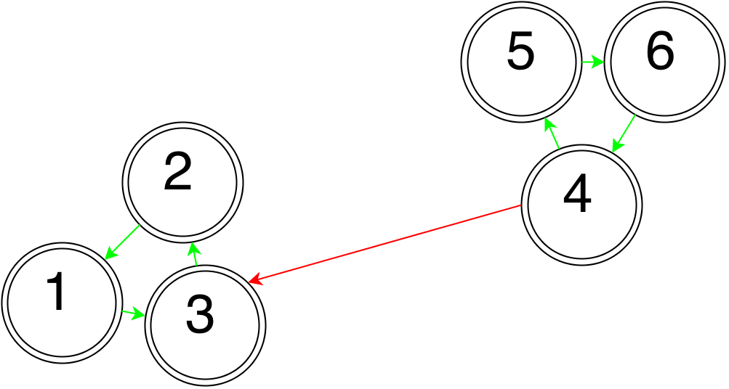
The Directed Rural Postman: Algorithms
Introduction
Conclusion
Schedule
Validation
Approach
Idea: Connect the components of the graph induced by the required arcs, and then solve a min-cost flow problem.
Step I: Simplify the graph.
Step II: Find an MST on the collapsed graph.
Step III: Solve a min-cost flow problem on the resulting graph.

Slide 41
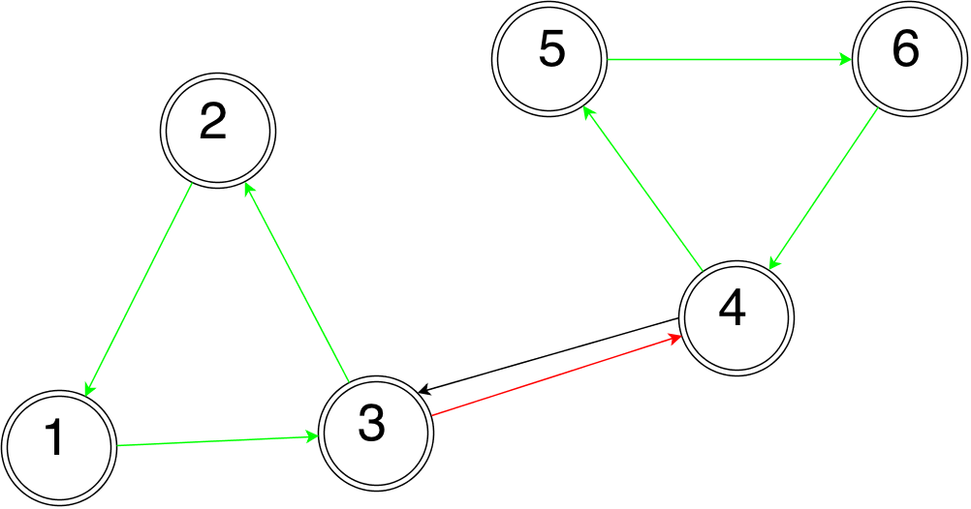
The Directed Rural Postman: Algorithms
Introduction
Conclusion
Schedule
Validation
Approach
Idea: Connect the components of the graph induced by the required arcs, and then solve a min-cost flow problem.
Step I: Simplify the graph.
Step II: Find an MST on the collapsed graph.
Step III: Solve a min-cost flow problem on the resulting graph.
Repeat Steps II and III, rooting the MST at each of the components, and picking the best solution.

Slide 42
The Directed Rural Postman: Algorithms II
Introduction
Conclusion
Schedule
Validation
Approach
Here, we model the problem as an WRPP, and apply the heuristic of Benavent, except that we first compute an MST over the connected components of the original graph, and add the corresponding edges to the required graph.

Slide 43
Validation / Verification
Introduction
Conclusion
Schedule
Validation
Approach
For UCPP, DCPP, and DRPP we’ll generate our own test instances for which the optimal solution will be known, or solved for using and IP formulation and an industrial grade solver.
For MCPP, and WPP, test on benchmark instances made public at http://www.uv.es/corberan/instancias.htm for which the optimal solution is known.
We shall use Wilcoxon’s Rank Sum test in order to validate the fact that our code is actually implementing the desired heuristic, taking results from the papers in which these are presented, and testing them against our solutions.

Slide 44
Databases
Introduction
Conclusion
Schedule
Validation
Approach
For some problems, we shall use instances made public by Angel Corberan:
Instances satisfy the connectivity assumptions of the problem.
Instances have integer costs along the edges.
Instances have no negative cost cycles.
We shall, in general check for these in the code so that our library exhibits predictable failure states.
For the rest of the problems, we shall randomly generate test instances which will also be posted with the other instances, and with the code.
These will be solved to optimality using the IP formulations presented here, and an industrial grade solver like CPLEX or Gurobi.
These will meet the same set of assumptions as Corberan’s instances.

Slide 45
Schedule
Introduction
Conclusion
Schedule
Validation
Approach
DCPP / UCPP Exact Solvers
September / October
MCPP Heuristics
November
WPP Heuristics
December
DRPP
January
Performance Optimization / Tuning
Extensibility (CPLEX / Gurobi, Gephi / Graphviz)
February
March – April
Investigate Plowing with Precedence
May

Slide 46
Implementation
Introduction
Conclusion
Schedule
Validation
Approach
The implementation language will be primarily in Java, with the option to write certain pieces in C++ if necessary, (using JNI).
The code will be tested on two different setups, on all major operating systems (Windows, OSX, Linux).
(Desktop) Intel i7 920 Processor, 2.67 GHz, 8GB RAM.
(Laptop) Macbook Air (2012).
Version control using Git.

Slide 47
Deliverables
Introduction
Conclusion
Schedule
Validation
Approach
To be hosted at my personal github at https://github.com/olibear .
Test instances
All code
Solvers
Graph architecture
Extensible interfaces and abstract classes
integrated utilities.
Documentation (including tutorials and a readme)
Mid-year and Final Report

Slide 48
References
Introduction
Conclusion
Schedule
Validation
Approach
Thimbleby, Harold. "The directed chinese postman problem." Software: Practice and Experience 33.11 (2003): 1081-1096.
http://www.ise.ncsu.edu/fangroup/or766.dir/or766_ch9.pdf
Eiselt, Horst A., Michel Gendreau, and Gilbert Laporte. "Arc routing problems, part I: The Chinese postman problem." Operations Research 43.2 (1995): 231-242.
Yaoyuenyong, Kriangchai, Peerayuth Charnsethikul, and Vira Chankong. "A heuristic algorithm for the mixed Chinese postman problem." Optimization and Engineering 3.2 (2002): 157-187.
Benavent, Enrique, et al. "New heuristic algorithms for the windy rural postman problem." Computers & operations research 32.12 (2005): 3111-3128.
Eiselt, Horst A., Michel Gendreau, and Gilbert Laporte. "Arc routing problems, part II: The rural postman problem." Operations Research 43.3 (1995): 399-414.
Campos, V., and J. V. Savall. "A computational study of several heuristics for the DRPP." Computational Optimization and Applications 4.1 (1995): 67-77. (Replace this with Carmine’s paper when I get it).
Dussault, Benjamin, et al. "Plowing with precedence: A variant of the windy postman problem." Computers & Operations Research (2012).
Win, Zaw. "On the windy postman problem on Eulerian graphs." Mathematical Programming 44.1-3 (1989): 97-112.
Christofides, Nicos, et al. "An algorithm for the rural postman problem on a directed graph." Netflow at Pisa. Springer Berlin Heidelberg, 1986. 155-166.

